Slide 1
Statistical Methods for Data Analysis the Bayesian approach
Luca Lista
INFN Napoli

Slide 2
Contents
Bayes theorem
Bayesian probability
Bayesian inference

Slide 3
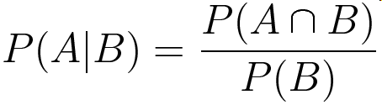
Conditional probability
Probability that the event A occurs given that B also occurs
A
B

Slide 4

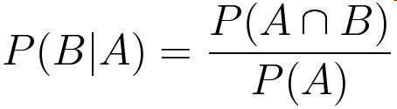
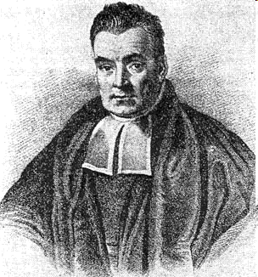
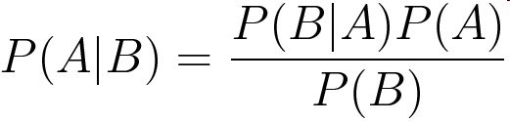
Bayes theorem
Thomas Bayes (1702-1761)
P(A) = prior probability
P(A|B) = posterior probability

Slide 5
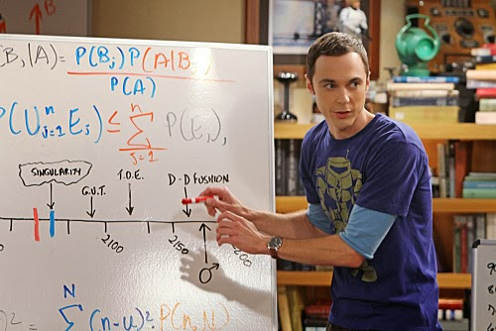
Here it is!
The Big Bang Theory © CBS

Slide 6
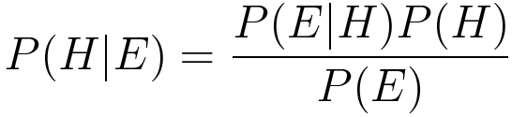
Bayesian posterior probability
Bayes theorem allows to determine probability about hypotheses or claims H that not related random variables, given an observation or evidence E:
P(H) = prior probability
P(H | E) = posterior probability, given E
The Bayes rule allows to define a rational way to modify one’s prior belief once some observation is known

Slide 7
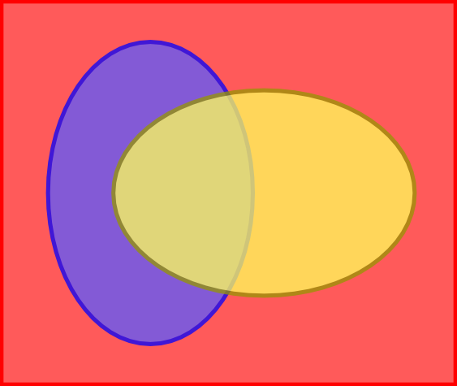

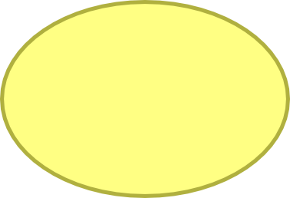


Pictorial view of Bayes theorem (I)
Ω
A
B
P(A) =
P(B) =
From a drawing
by B.Cousins
P(A|B) =
P(B|A) =

Slide 8
Pictorial view of Bayes theorem (II)
×
P(A|B) P(B) =
=
= P(A ∩ B)
×
P(B|A) P(A) =
=
= P(A ∩ B)

Slide 9
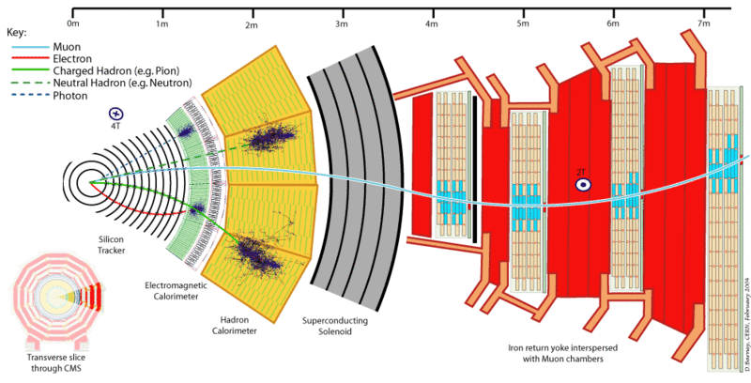
Example (frequentist): muon fake rate
A detector identifies muons with high efficiently, ε = 95%
A small fraction δ = 5% of pions are incorrectly identified as muons (“fakes”)
If a particle is identified as a muon, what is the probability it is really a muon?
  The answer also depends on the composition of the sample!
  i.e.: the fraction of muons and pions in the overall sample
This example is usually presented as an epidemiology case.
Naïve answers about fake positive probability are often wrong!

Slide 10
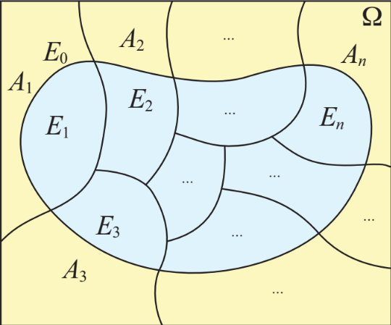
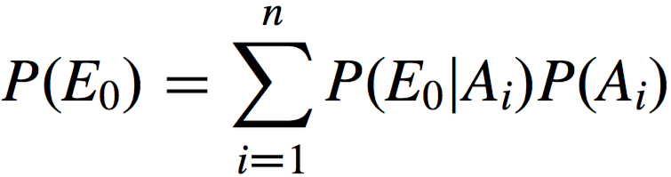
Fakes and Bayes theorem
Law of total probability
Using Bayes theorem:
  P(μ|+) = P(+|μ) P(μ) / P(+)
Where our inputs are:
  P(+|μ) = ε = 0.95, P(+|π) = δ = 0.05
We can decompose P(+) as:
  P(+) = P(+|μ) P(μ) + P(+|π) P(π)
Putting all together:
  P(μ|+) = ε P(μ) / (ε P(μ) + δ P(π))
Assume we have a sample made of P(μ)=4% muons and P(π)=96% pions, we have:
  P(μ|+) = 0.95 × 0.04 / (0.95 × 0.04 + 0.05 × 0.96) ≅ 0.44
Even if the selection efficiency is very high, the low sample purity makes P(μ|+) lower than 50%.
+ denotes a positive id
normalization
term
E₀ = ‘+’, A_{i} = μ, π

Slide 11
Before any muon id. information
Muons: P(μ) = 4%
All particles:
P(Ω) = 100%
Pions: P(π) = 96%

Slide 12
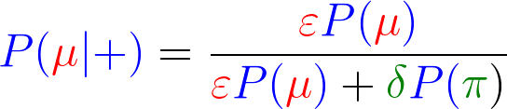
After the muon id. measurement
P(+) = 8.6%
P(+|μ) = ε = 95%
P(−|μ) = 1 − ε = 5%
Muons: P(μ) = 4%
P(−) = 91.4%
P(+|π) = δ = 5%
Pions: P(π) = 96%
P(−|π) =1 − δ = 95%

Slide 13
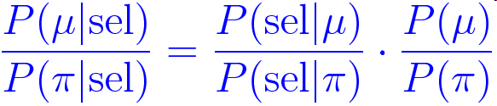
Prob. ratios and prob. inversion
Another convenient way to re-state the Bayes posterior is through ratios:
No need to consider all possible hypotheses (not known in all cases)
Clear how the ratio of priors plays a role

Slide 14
An example from epidemiology
A person received a diagnosis of a serious illness (say H1N1, or worse…)
The probability to detect positively a ill person is ~100%
The probability to give a positive result on a healthy person is 0.2%
What is the probability that the person is really ill?
Is 99.8% a reasonable answer?
G. Cowan, Statistical data analysis 1998,
G. D'Agostini, CERN Academic Training, 2005

Slide 15
Hypothetical population
Population:
10000
Ill
17
Ill, diagn.
17
Ill, no diagn.
0
Healthy
9983
Healthy, diagn.
20
Healthy, no diagn.
9963

Slide 16
Conditional probability
Probability to be really ill =
conditioned probability after the event of the positive diagnosis
  P(+ | ill) = 100%, P(− | ill) << 1
  P(+ | healthy) = 0.2%, P(− | healthy) = 99.8%
Using Bayes theorem:
  P(ill | +) = P(+ | ill) P(ill) / P(+) ≅ P(ill) / P(+)
We need to know:
  P(ill) = probability that a random person is ill (<< P(healthy))
And we have:
  Using: P(ill) + P(healthy) = 1 and P(ill and healty) = 0
  P(+) = P(+ | ill) P(ill) + P(+| healthy) P(healthy)
  ≅ P(ill) + P(+ | healthy)

Slide 17
Pictorial view
P(+|healty)
P(+|ill)
≅ 1
P(−|healthy)
P(ill)
P(healthy) ≅ 1

Slide 18
Pictorial view
P(+|healty)
P(healthy|+)
P(+|ill)
≅ 1
P(ill|+) + P(healthy|+) = 1
P(−|healthy)
P(ill|+)
P(ill)
P(healthy) ≅ 1

Slide 19
Adding some numbers
Probability of being really ill:
  P(ill | +) = P(ill)/P(+)
  ≅ P(ill) / (P(ill) + P(+ | healthy))
If:
  P(ill) = 0.17%, P(+ | healthy) = 0.2%
We have:
  P(ill | +) = 17 / (17 + 20) = 46%

Slide 20
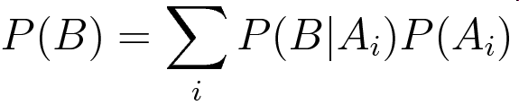
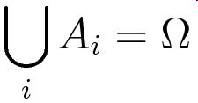
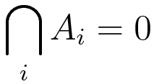
Bayesian probability as learning
Before the observation B, our degree of belief of A is P(A) (prior probability)
After observing B, our degree of belief changes into P(A | B) (posterior probability)
Probability can be expressed also as a property of non-random variables
  E.g.: unknown parameter, unknown events
Easy approach to extend knowledge with subsequent observation
  E.g. combine experiment = multiply probabilities
Easy to cope with numerical problems
Consider P(B) as a normalization factor:
if
and

Slide 21
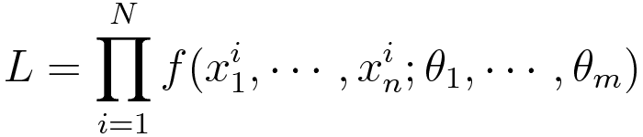
The likelihood function
In many cases, the outcome of our experiment can be modeled as a set of random variables x₁, …, x_{n} whose distribution takes into account:
  intrinsic sample randomness (quantum physics is intrinsically random),
  detector effects (resolution, efficiency, …).
Theory and detector effects can be described according to some parameters θ₁, ..., θ_{m}, whose values are, in most of the cases, unknown
The overall PDF, evaluated at our observation x₁, …, x_{n}, is called likelihood function:
In case our sample consists of N independent measurements (collision events) the likelihood function can be written as:

Slide 22
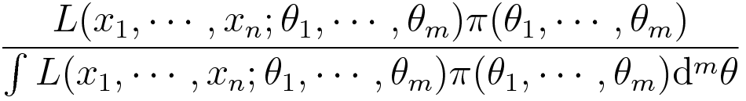
Bayes rule and likelihood function
Given a set of measurements x₁, …, x_{n}, Bayesian posterior PDF of the unknown parameters θ₁, …, θ_{m} can be determined as:
Where π(θ₁, …, θ_{m}) is the subjective prior probability
The denominator ∫ L(x, θ ) π(θ ) d^{m}θ is a normalization factor
The observation of x₁, …, x_{n} modifies the prior knowledge of the unknown parameters θ₁, …, θ_{m}
If π(θ₁, …, θ_{m}) is sufficiently smooth and L is sharply peaked around the true values θ₁, …, θ_{m}, the resulting posterior will not be strongly dependent on the prior’s choice

Slide 23
Repeated use of Bayes theorem
Bayes theorem can be applied sequentially for repeated independent observations (posterior PDF = learning from experiments)
P₀ = Prior
Note that applying Bayes theorem directly
from prior to (obs1 + obs2) leads to the
same result:
P₁₊₂ = P₀ ⨉ L₁₊₂ = P₀ ⨉ L₁ ⨉ L₂ = P₂
Prior
P₁ ∝ P₀ ⨉ L₁
observation 1
Conditioned posterior 1
P₂ ∝ P₁ ⨉ L₂ ∝ P₀ ⨉ L₁ ⨉ L₂
observation 2
Conditioned posterior 2
P₃ ∝ P₀ ⨉ L₁ ⨉ L₂ ⨉ L₃
observation 3
Composite likelihood = product of individual likelihoods
(for independent observations)
Conditioned posterior 3

Slide 24
Bayesian in decision theory
You need to decide to take some action after you have computed your degree of belief
  E.g.: make a public announcement of a discovery or not
What is the best decision?
The answer also depends on the (subjective) cost of the two possible errors:
  Announce a wrong answer
  Don’t announce a discovery (and be anticipate by a competitor!)
Bayesian approach fits well with decision theory, which requires two subjective input:
  Prior degree of belief
  Cost of outcomes

Slide 25
Falsifiability within statistics
With Aristotle’s or “Boolean” logic, if a cause A forbids the observation of the effect B, observing the effect B implies that A is false
Naively migrating to random possible events (B_{i}) with different (uncertain!) hypotheses (A_{j}) would lead to:
  Observing an event B_{i} that
  has very low probability,
  given a cause A_{j}, implies
  that A_{j} is very unlikely
False!!!!

Slide 26
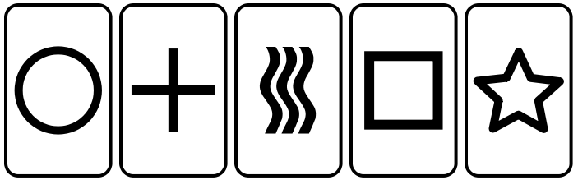
Detection of paranormal phenomena
A person claims he has Extrasensory Perception (ESP)
He can “predict” the outcome of card extraction with much higher success rate than random guess
What is the (Bayesian) probability he really has ESP?

Slide 27
Simpleton, ready to believe!
If (prior) P(ESP) ≅ P(!ESP) ≅ 0.5
  → P(ESP|predict) ≅ 1 (posterior)
  A single experiment demonstrates ESP!
P(predict|!ESP) << 1
P(predict|ESP) ≅ 1
P(ESP)
P(!ESP)

Slide 28
With a skeptical prior prejudice
If (prior) P(ESP) << P(!ESP)
  → P(ESP|predict) <∼ 0.5 (at least uncertain!)
  More experiments? More hypotheses?
P(predict|!ESP) << 1
P(predict|ESP) ≅ 1
P(ESP)
P(!ESP)

Slide 29
Maybe he is cheating?
How likely is cheating? Assume: P(ESP) << P(cheat)
  → P(ESP|predict) ≅ 0 (cheating more likely!)
  The ESP guy should now propose alternative hypotheses!
P(predict|!ESP) << 1
P(predict|ESP)
≅ P(predict|cheat)
≅ 1
P(ESP)
P(cheat)
P(no ESP, not cheat)

Slide 30
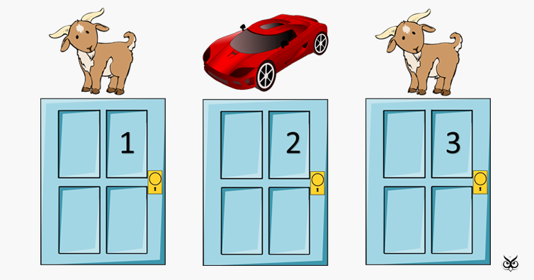
Exercise: monty hall
Behind a door there is either a car or a goat
You pick a door, but can’t open it
The host opens another door where there is a goat
The host proposes you to switch your door with the remaining one
Should you switch or stick with your choice?

Slide 31
Inference
Determinig information about unknown parameters using probability theory
Probability
Theory Model
Data
Data fluctuate according
to process randomness
Inference
Theory Model
Data
Model parameters uncertainty due to fluctuations of the data sample

Slide 32
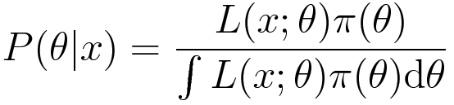
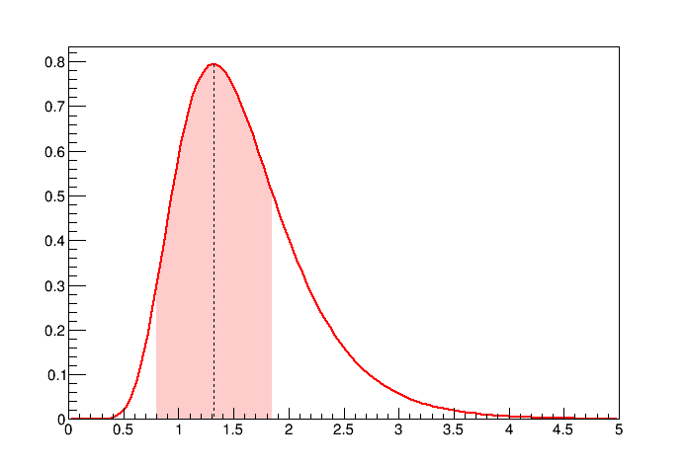
Bayesian inference
The posterior PDF provides all the information about the unknown parameters (let’s assume here it’s just a single parameter θ for simplicity)
Given P(θ |x), we can determine:
  The most probable value
  (best estimate)
  Intervals corresponding to a
  specified probability
Notice that if π(θ ) is a constant,
the most probable value of θ
correspond to the maximum of
the likelihood function
P(θ|x)
p = 68.3%, as 1σ
for a Gaussian
δ
δ
θ

Slide 33
Frequentist inference
Assigning a probability level of an unknown parameter makes no sense in the frequentist approach
  Parameters are not random variables!
A frequentist inference procedure determines a central value and an uncertainty interval that depend on the observed measurements
The central value and interval extremes are random variables
No subjective element is introduced in the determination
The function that returns the central value given an observed measurement is called estimator
  Different estimator choices are possible, the most frequently adopted is the maximum likelihood estimator because of its statistical properties discussed in the following

Slide 34

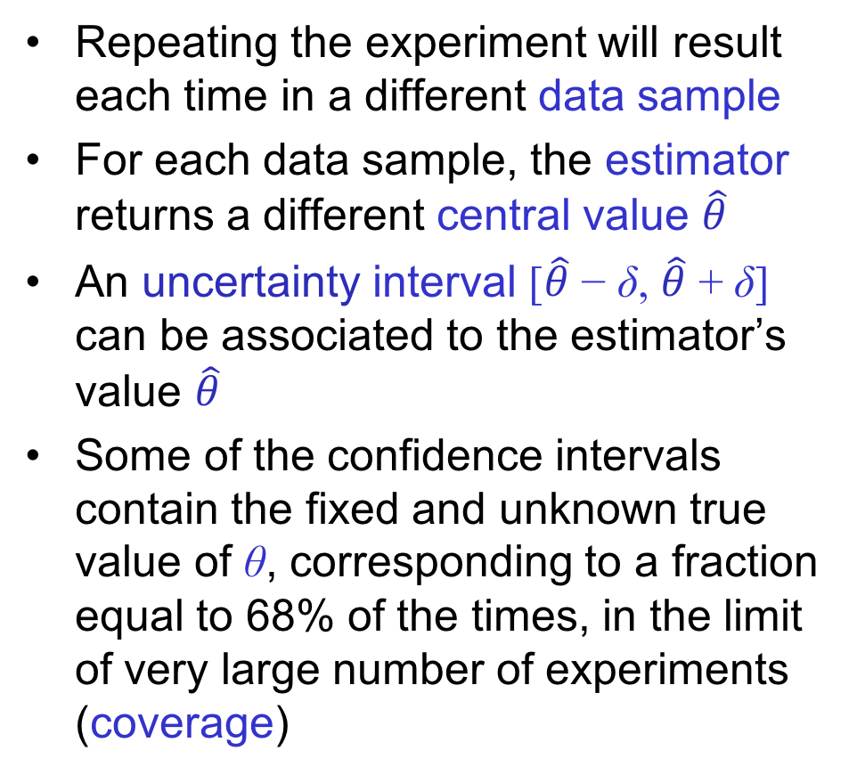
Frequentist coverage
True value of θ
  Repeating the experiment will result each time in a different data sample
  For each data sample, the estimator returns a different central value $\hat{θ}$
  An uncertainty interval [$\hat{θ}$ − δ, $\hat{θ}$ + δ] can be associated to the estimator’s value $\hat{θ}$
  Some of the confidence intervals contain the fixed and unknown true value of θ, corresponding to a fraction equal to 68% of the times, in the limit of very large number of experiments (coverage)
Repeated experiments
$$\hat{θ}$$

Slide 35
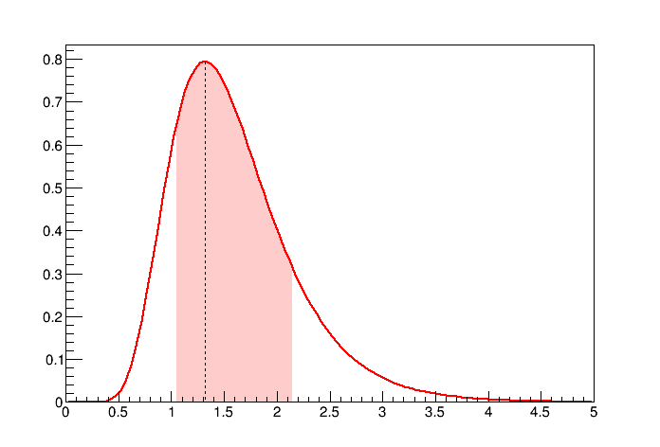
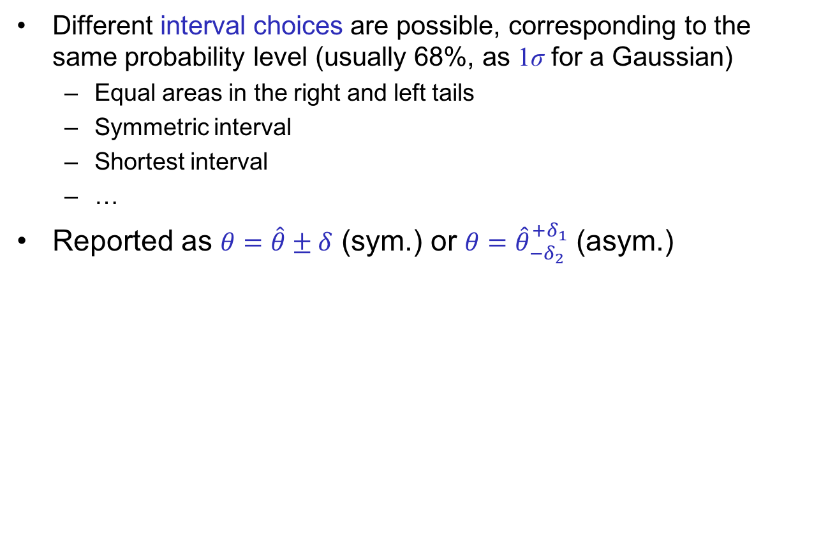
Choice of 68% prob. intervals
Different interval choices are possible, corresponding to the same probability level (usually 68%, as 1σ for a Gaussian)
  Equal areas in the right and left tails
  Symmetric interval
  Shortest interval
  …
Reported as $θ=\hat{θ}±δ$ (sym.) or $θ={\hat{θ}}_{−δ_{2}}^{+δ_{1}}$ (asym.)
All equivalent for a
symmetric distribution
(e.g. Gaussian)
Equal tails interval
Symmetric interval
P(θ)
P(θ)
p = 68.3%
p = 68.3%
p = 15.8%
p = 15.8%
δ
δ
θ
θ

Slide 36
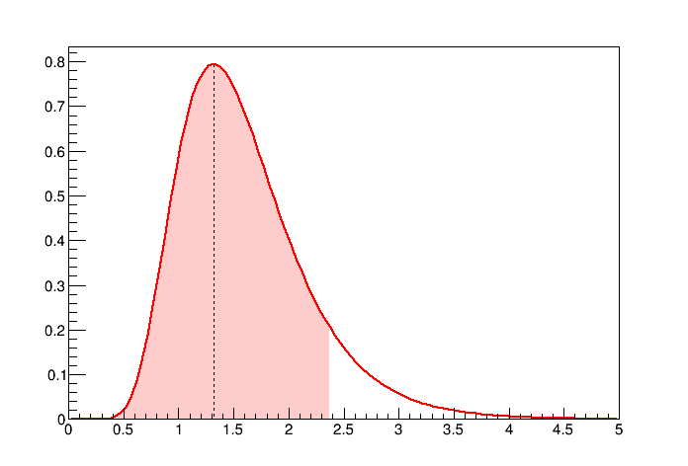
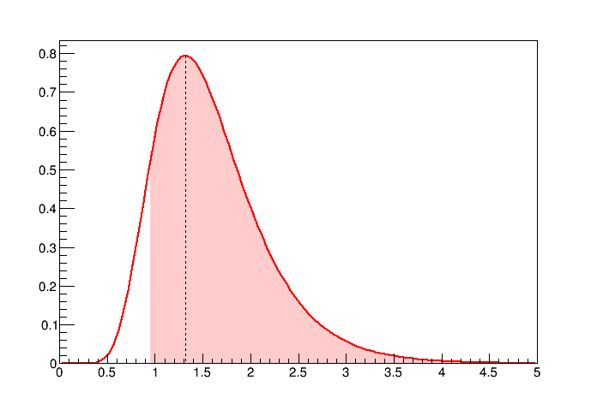
Upper and lower limits
A fully asymmetric interval choice is obtained setting one extreme of the interval to the lowest or highest allowed range
The other extreme indicates an upper or lower limits to the “allowed” range
For upper or lower limits, usually a probability of 90% or 95% is preferred to the usual 68% adopted for central intervals
Reported as: θ < θ^{up} (90% CL) or θ > θ^{lo} (90% CL)
P(θ)
P(θ)
p = 90%
p = 90%
θ
θ

Slide 37
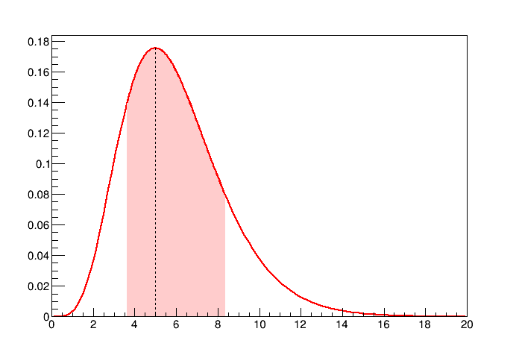
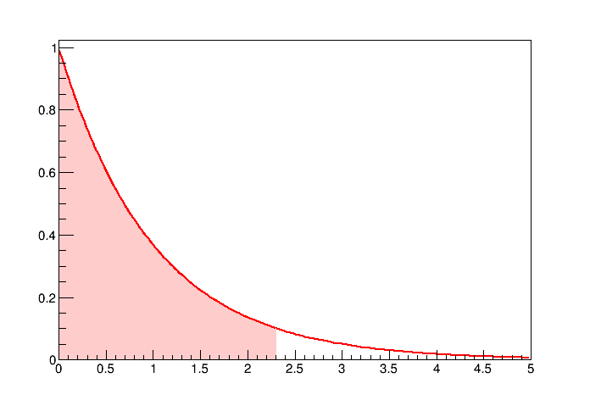


Bayesian inference of a Poissonian
Posterior PDF, assuming
the prior to be π(s):
If is π(s) is uniform:
Note: ,
For n = 0, one may quote an upper limit at 90% or 95% CL:
s < 2.303 (90% CL)
s < 2.996 (95% CL)
P(s|n)
n = 5
f(s|n) = max ➔ s = n
p = 15.8%
p = 15.8%
s
P(s|0)
n = 0
f(s|0) = e^{−s}
zero observed
events
p = 10%
s

Slide 38
Error propagation: Bayesian inference
Applying a parameter transformation, say η = H(θ), results in a transformed central value and transformed uncertainty interval
The error propagation can be done transforming the posterior PDF, then computing the interval on the transformed PDF:
Transformations for cases with more than one variable proceed in a similar way:
  η = H(θ₁, θ₂) :
  η₁ = H₁(θ₁, θ₂), η₁ = H₁(θ₁, θ₂):

Slide 39
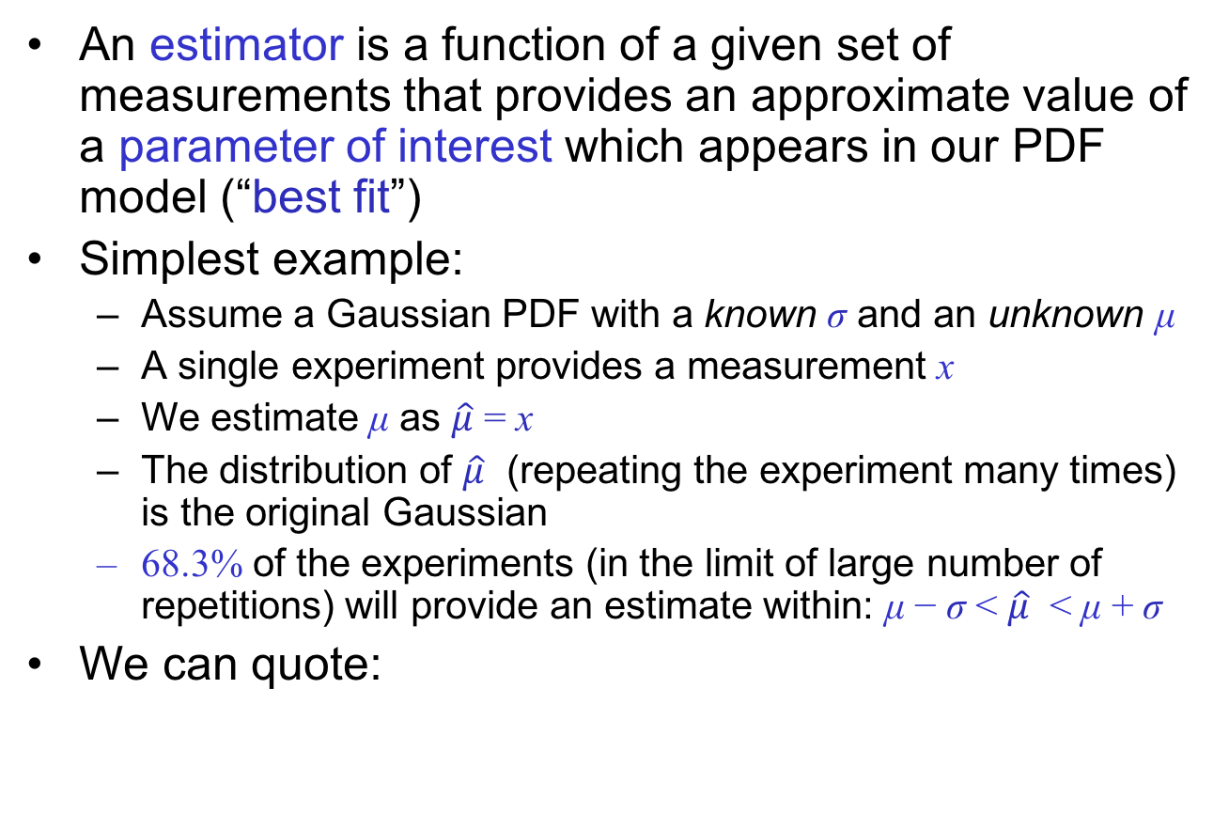
Frequentist inference:
An estimator is a function of a given set of measurements that provides an approximate value of a parameter of interest which appears in our PDF model (“best fit”)
Simplest example:
  Assume a Gaussian PDF with a known σ and an unknown μ
  A single experiment provides a measurement x
  We estimate μ as $\hat{μ}$ = x
  The distribution of $\hat{μ}$ (repeating the experiment many times) is the original Gaussian
  68.3% of the experiments (in the limit of large number of repetitions) will provide an estimate within: μ − σ < $\hat{μ}$ < μ + σ
We can quote:
μ = x ± σ

Slide 40

The maximum-likelihood method
The maximum-likelihood estimator is the most adopted parameter estimator
The “best fit” parameters correspond to the set of values that maximizes the likelihood function
  Good statistical properties (→ next slides)
The maximization can be performed analytically only in the simplest cases, and numerically for most of realistic cases
Minuit is historically the most widely used minimization engine in High Energy Physics
  F. James, 1970’s; rewritten in C++ and released
  under CERN’s ROOT framework

Slide 41
B. & F. in the scientific process
Observation of
new phenomenon
Experiment
How likely is the
interpretation?
Strong skeptical
prejudice motivates
confirmation:
repeat the experiment and find other
evidences
(→ run into the frequentis domain!)
Bayesian probabilistic interpretation
of the new phenomenon:
what is the probability that
the interpretation is correct?
Bayesian and frequentis approaches have complementary roles in this process

Slide 42
How to compute Posterior PDF
Perform analytical integration
  Feasible in very few cases
Use numerical integration
  May be CPU intensive
Markov Chain Monte Carlo
  Sampling parameter space efficiently using a random walk heading to the regions of higher probability
  Metropolis algorithm to sample according to a PDF f(x)
    Start from a random point, x_{i}, in the parameter space
    Generate a proposal point x_{p} in the vicinity of x_{i}
    If f(x_{p}) > f(x_{i}) accept as next point x_{i}+1 = x_{p}
    else, accept only with probability p = f(x_{p}) / f(x_{i})
    Repeat from point 2
  Convergence criteria and step size
  must be defined
RooStats::BayesianCalculator
RooStats::MCMCCalculator

Slide 43
Problems of Bayesian approach
The Bayesian probability is subjective, in the sense that it depends on a prior probability, or degrees of belief about the unknown parameters
  Anyway, increasing the amount of observations, the posterior probability with modify significantly the prior probability, and the final posterior probability will depend less from the initial prior probability
  … but under those conditions, using frequentist or Bayesian approaches does not make much difference anyway
How to represent the total lack of knowledge?
  A uniform distribution is not invariant under coordinate transformations
  Uniform PDF in log θ is scale-invariant
Study of the sensitivity of the result on the chosen prior PDF is usually recommended

Slide 44
Frequentist vs Bayesian intervals
Interpretation of parameter errors:
  θ = θ^{est} ± δ θ ∈[ θ^{est} − δ, θ^{est} + δ]
  θ = θ^{est} ^{+δ2}_{−δ1} θ ∈[ θ^{est} − δ₁, θ^{est} + δ₂]
Frequentist approach:
  Knowing a parameter within some error means that a large fraction (68% or 95%, usually) of the experiments contain the (fixed but unknown) true value within the quoted confidence interval:
  [θ^{est} − δ₁, θ^{est} + δ₂]
Bayesian approach:
  The posterior PDF for θ is maximum at θ^{est} and its integral is 68% within the range [θ^{est} − δ₁, θ^{est}+ δ₂]
The choice of the interval, i.e.. δ₁ and δ₂ can be done in different ways, e.g: same area in the two tails, shortest interval, symmetric error, …
Note that both approaches provide the same results for a Gaussian model using a uniform prior, leading to possible confusions in the interpretation

Slide 45
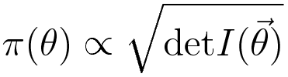
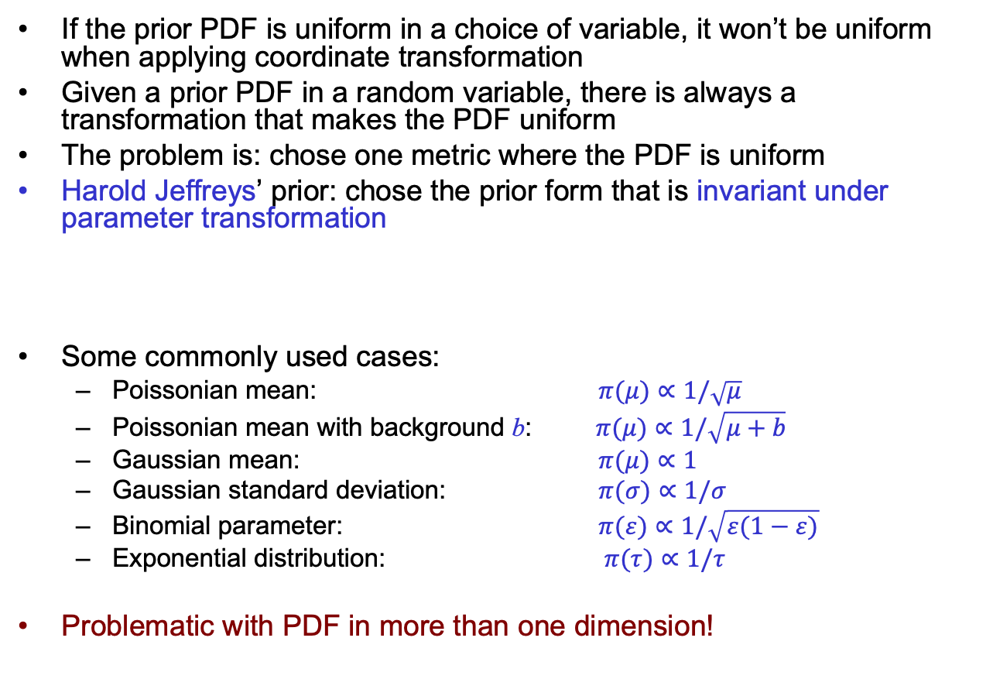
Choosing the prior PDF
If the prior PDF is uniform in a choice of variable, it won’t be uniform when applying coordinate transformation
Given a prior PDF in a random variable, there is always a transformation that makes the PDF uniform
The problem is: chose one metric where the PDF is uniform
Harold Jeffreys’ prior: chose the prior form that is invariant under parameter transformation
Some commonly used cases:
  Poissonian mean: $π(μ)∝1/\sqrt{μ}$
  Poissonian mean with background b: $π(μ)∝1/\sqrt{μ+b}$
  Gaussian mean: $π(μ)∝1$
  Gaussian standard deviation: $π(σ)∝1/σ$
  Binomial parameter: $π(ε)∝1/\sqrt{ε(1−ε)}$
  Exponential distribution: $π(τ)∝1/τ$
Problematic with PDF in more than one dimension!

Slide 46
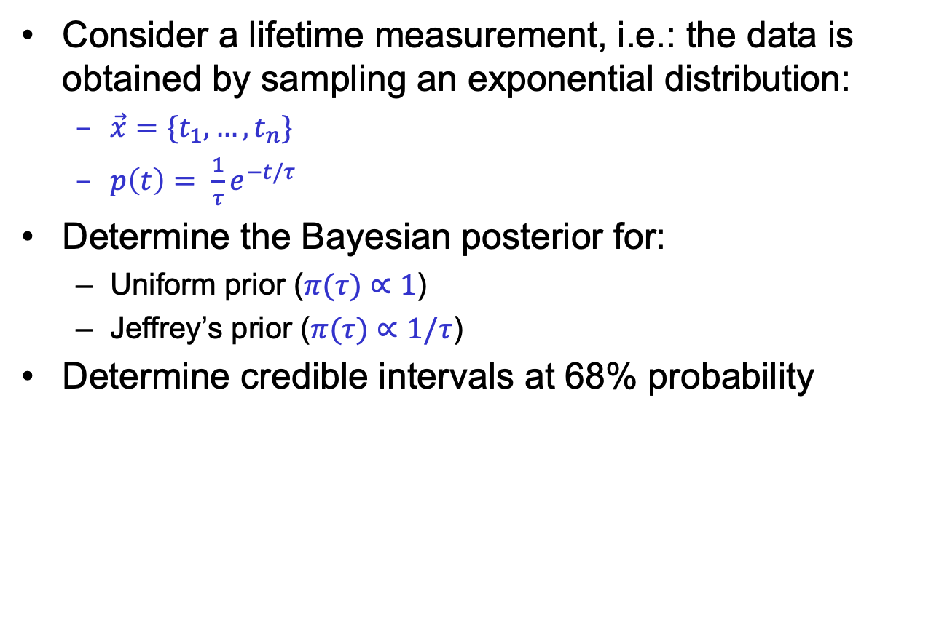
Exercise: lifetime measurement
Consider a lifetime measurement, i.e.: the data is obtained by sampling an exponential distribution:
  $\vec{x}=\{t_{1},…, t_{n}\}$
  $p\left(t\right)= \frac{1}{τ}e^{−t/τ}$
Determine the Bayesian posterior for:
  Uniform prior ($π(τ)∝1$)
  Jeffrey’s prior ($π(τ)∝1/τ$)
Determine credible intervals at 68% probability

Slide 47
Frequentist vs Bayesian popularity
Until 1990’s frequentist approach largely favored:
  “at the present time (1997) [frequentists] appear to constitute the vast majority of workers in high energy physics”
    V.L.Highland, B.Cousins, NIM A398 (1997) 429-430
More recently, Bayesian estimates are getting popular and provide simpler mathematical methods to perform complex estimates
  Bayesian estimators properties can be studied with a frequentistic approach using Toy Monte Carlos (feasible with today’s computers)
  Also preferred by several theorists (UTFit team, cosmologists)
LHC Higgs boson search set a new level of standards for frequentist applications
  Asymptotic approximations reduce computing time
  Common software tools provide easy-to-use implementations

Slide 48
A Bayesian application: UTFit
UTFit: Bayesian determination of the CKM unitarity triangle
  Many experimental and theoretical inputs combined as product of PDF
  Resulting likelihood interpreted as Bayesian PDF in the UT plane
Inputs:
  Experimental results that directly or indirectly measure or put constraints on Standard Model CKM Parameters

Slide 49
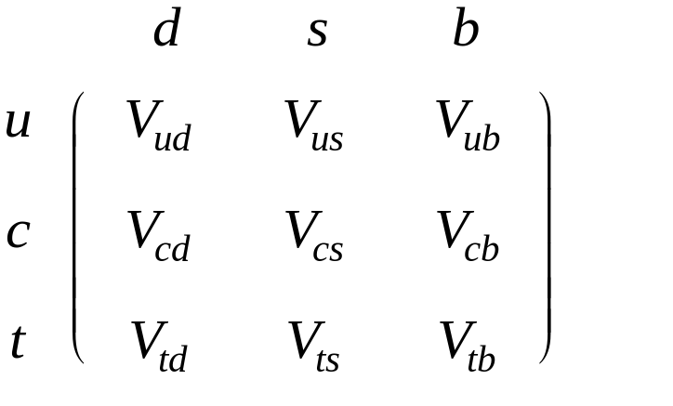



The Unitarity Triangle
Quark mixing is described
by the CKM matrix
Unitarity relations on matrix
elements lead to a triangle
in the complex plane
A=(ρ,η)
α
γ
β
B=(1,0)
C=(0,0)
1

Slide 50
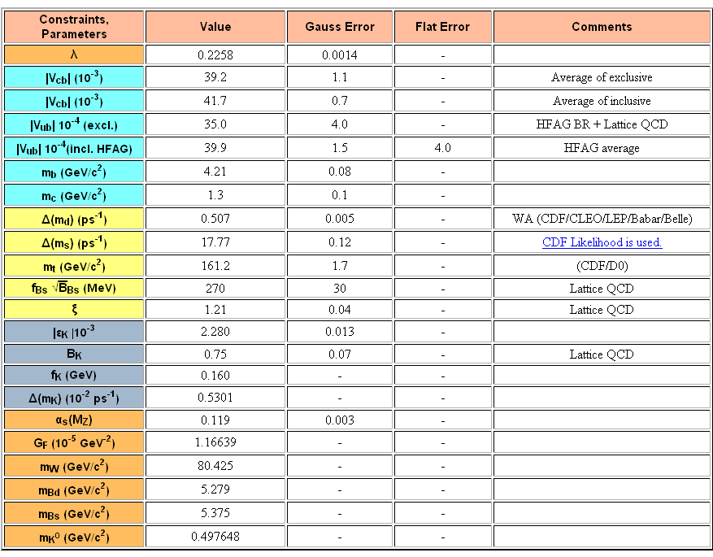
Inputs

Slide 51
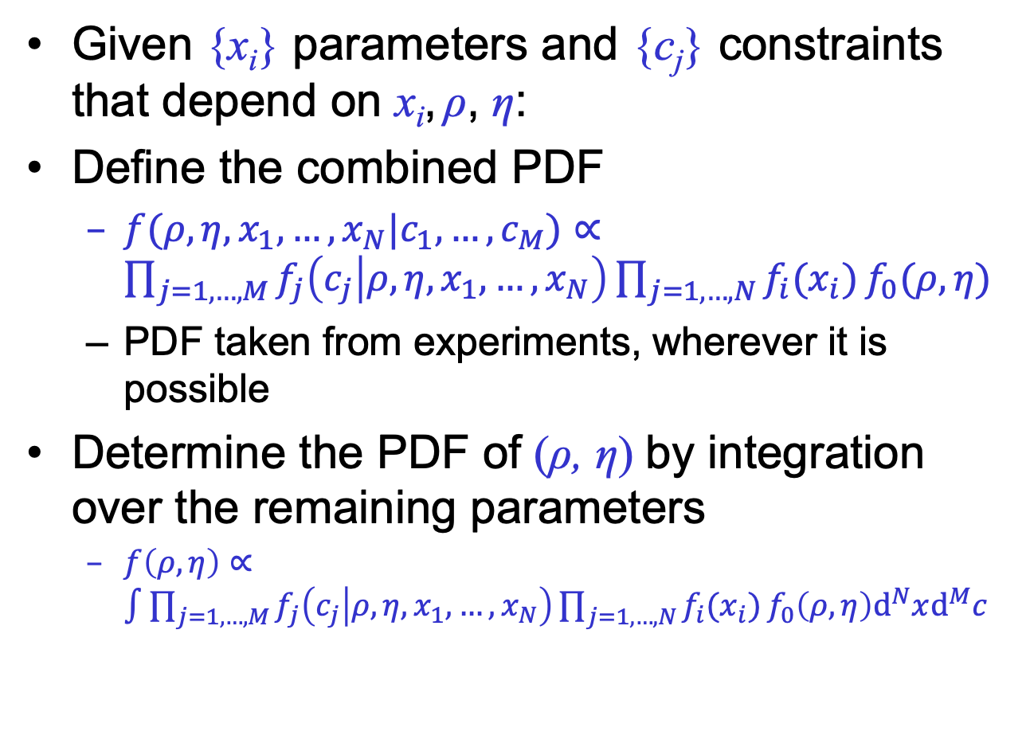
Combine the constraints
Given {x_{i}} parameters and {c_{j}} constraints that depend on x_{i}, ρ, η:
Define the combined PDF
  $f(ρ,η,x_{1}, …, x_{N}|c_{1}, …, c_{M})∝\prod_{j=1,…,M}{f_{j}\left(c_{j} | ρ, η,x_{1}, …, x_{N}\right)}\prod_{j=1,…,N}{f_{i}(x_{i}\text{)}}f_{0}(ρ, η)$
  PDF taken from experiments, wherever it is possible
Determine the PDF of (ρ, η) by integration over the remaining parameters
  $f\left(ρ,η\right)∝\int{{\prod_{j=1,…,M}{f_{j}\left(c_{j} | ρ, η,x_{1}, …, x_{N}\right)}\prod_{j=1,…,N}{f_{i}(x_{i}\text{)}}f_{0}\left(ρ, η\right)d}^{N}xd^{M}c }$
Prior PDF

Slide 52
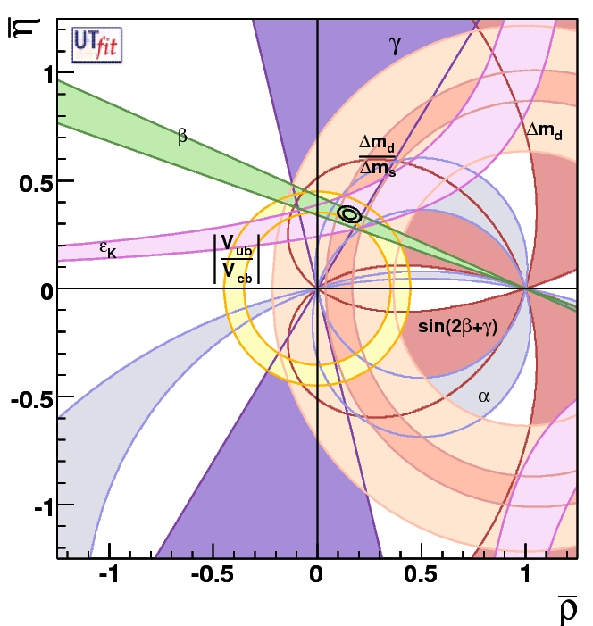
Unitarity Triangle fit
68%, 95%
contours

Slide 53
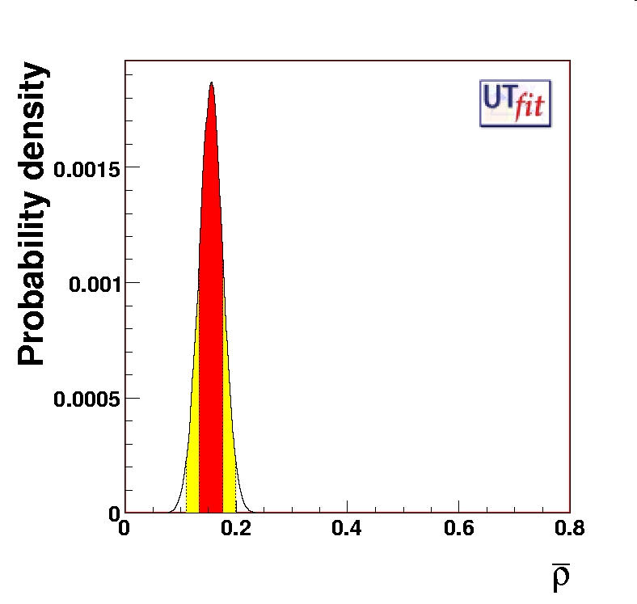
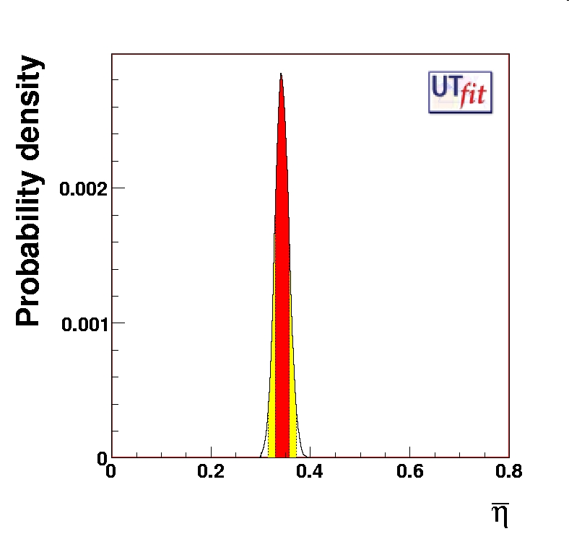
PDFs for ρ and η

Slide 54
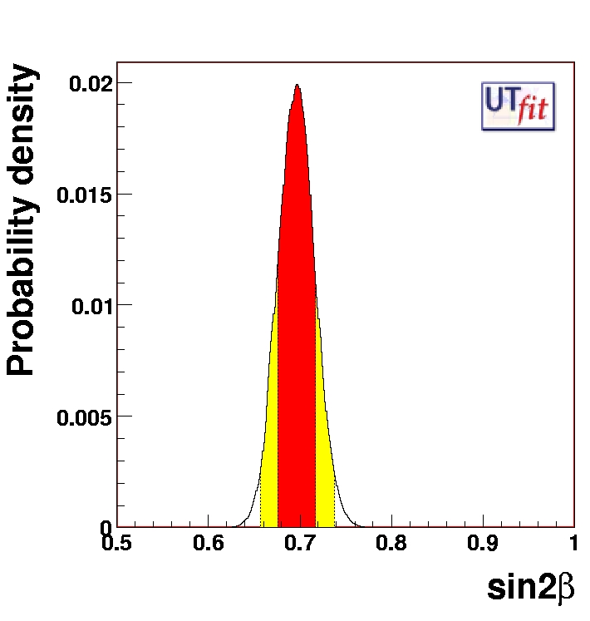
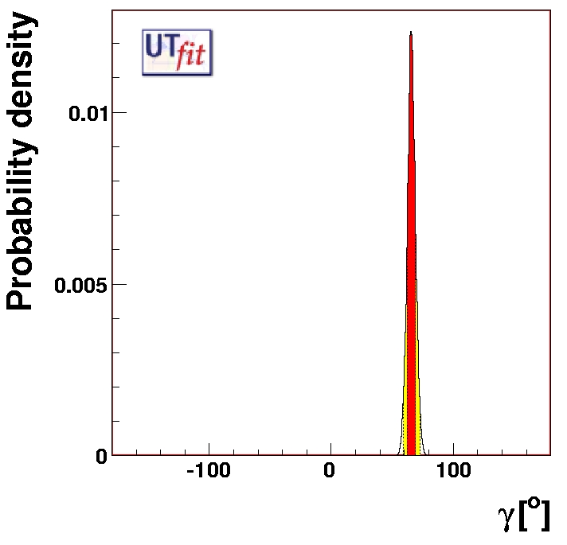
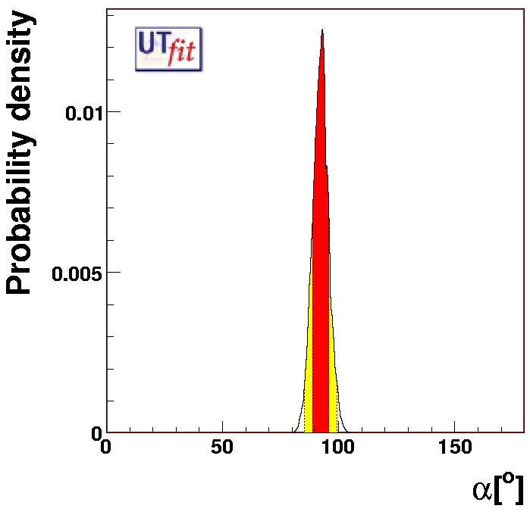
Projections on other observables

